Slide 1
Modeling, Learning and Inference in Linear-Chain Conditional Random Fields (CRFs)
Anmol Dwivedi

Slide 2
Outline
Modeling Linear-Chain CRFs (LC-CRF) using relevant feature functions
Challenges of parameter learning in LC-CRFs and equations
Inference algorithms for LC-CRF
Experiments and Results
All the above with application to hand-written word recognition*

Slide 3
Consider the task of inferring hand-written words.
Let denote observed characters of a word (input word is an image)
Let denote labels to respectively.
One approach is to train a Neural Network/logistic regression model for
each separately.
However, makes the framework agnostic to dependencies present among variables

Slide 4
Solution: Linear-Chain CRFs
Essentially an undirected graphical model over nodes
Choice for ?

Slide 5
is modeled using Log-linear models with user defined features
Choice for feature function set ?

Slide 6
Conditional features
Pairwise features
Singleton features
Input feature for is 8x4 image with 0’s and 1’s.
26 x 26 possible pairwise feature parameters
26 possible singleton feature parameters
26 x 32 x 2 possible conditional feature parameters
A total of (26 x 32 x 2) + (26 x 26) + (26) = 2366 parameters to learn from data!

Slide 7
Parameter Learning in CRFs: Training Phase
Given the discussed log-linear model and features, the goal is to learn all the 2366 parameters form training data.
Consider the training dataset we seeks to maximize the conditional log likelihood.

Slide 8
Expected model feature counts
Expected Data feature counts
Summation of indicator functions

Slide 9
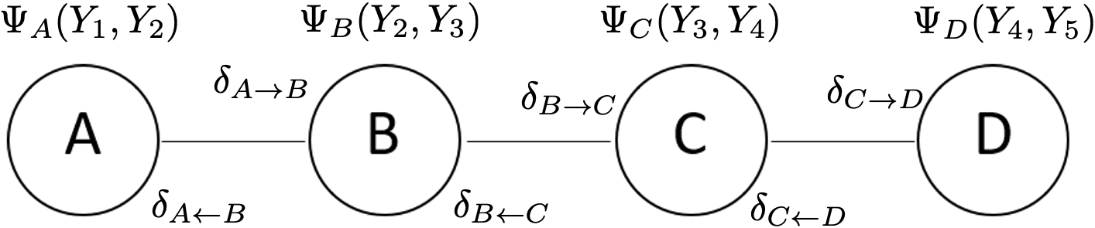
Inference in CRFs: Training Phase
B
D
A
C
Construct Junction Tree
Compute Beliefs
Compute all messages

Slide 10
After computing all messages and beliefs for training examples
Junction tree Sum Product belief propagation
Normalize beliefs to obtain in order to perform gradient update on training data.
Multiply any two unnormalized messages into a clique
and marginalize to obtain the partition function
Junction tree Max Sum belief propagation
On new test data, perform max-sum inference using the same beliefs and messages in order to infer the hand-written word.

Slide 12
Test Dataset consists of 80 examples.
Linear Chain CRF Character Level Accuracies: 61%
Linear Chain CRF Word Level Accuracies: 31%
Logistic regression Character Level Accuracies: 50.4%
Logistic regression CRF Word Level Accuracies: 12.5%

Slide 13
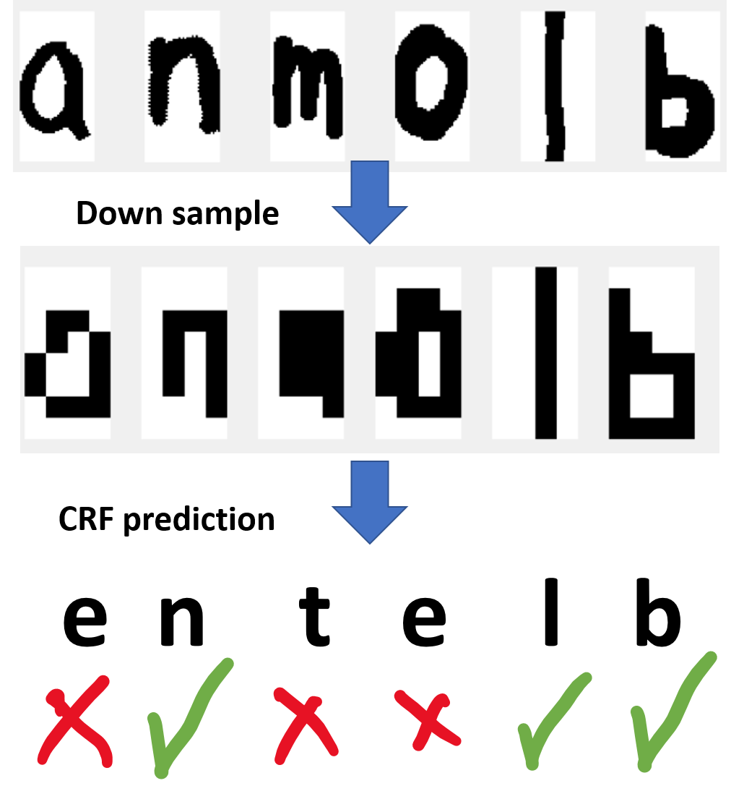

Slide 14
Thank You

